Slide 1

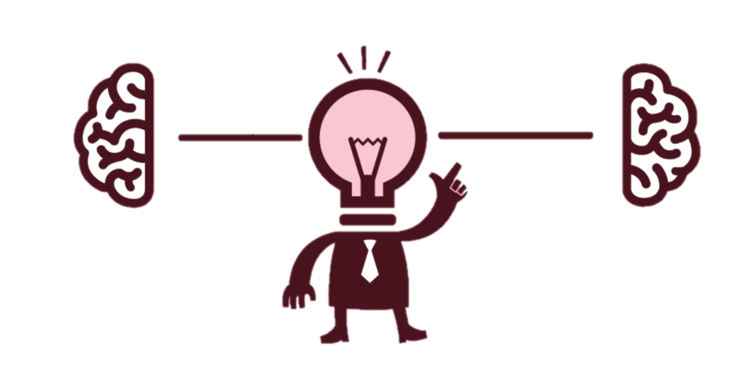
CRITICAL THINKING
Nipun Goyal 21BCE1237 Shrey Jain 21BCE5546
Faheema Kattakath Sanil 21BCE5518 Vidhi Shah 21BCE1297
Notes:
Good Morning! everyone present. Today we will talk about critical thinking.

Slide 2

What is Critical Thinking?
Intellectual ability to think rationally and logically to form a decisive judgement.
Think outside the box and analyze the evidence and facts independently.
Notes:
So what is critical thinking?
Critical thinking is the ability to think clearly and logically to form ** judgement/conclusion.
We need to put aside pre-conceived notions and analyze the information that is received independently.
**Add statement here**

Slide 3


Essentials of Critical Thinking Include:
Observation
Analysis
Inference
Problem Solving

Slide 4
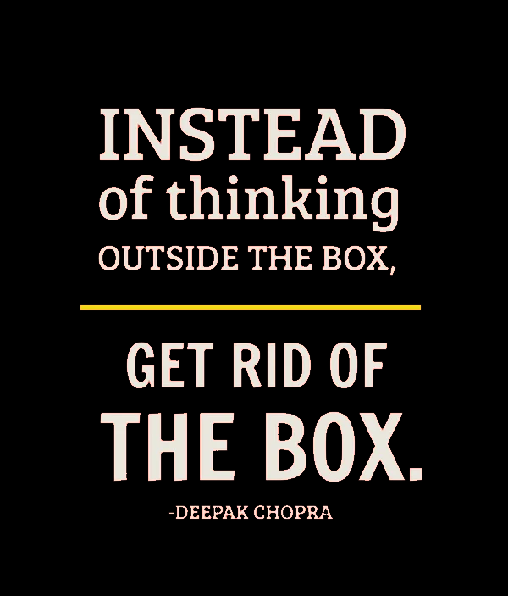
Critical Thinking Helps In:
Effective decision making
Strengthening other soft skills
Cultivating creativity and curiosity
Forming well-informed opinions
Notes:
Key to successful career

Slide 5
THANK YOU

